Slide 1
Foundations of Yoga & Trauma
Mike Huggins
President & Founder, July 2020

Slide 2
Our Mission
Transformation Yoga Project serves people impacted by trauma, addiction, and incarceration through trauma-sensitive, mindfulness-based yoga programs driven by education and research.
How we serve
Our highly-trained instructors offer a breath-centered yoga practice based on proven methods to decrease symptoms of anxiety and depression, activate the relaxation response, lower blood pressure, and reduce stress.
Where we serve
We facilitate classes and workshops in (JUSTICE) state prisons, federal prisons, county jails, juvenile detention centers, alternative high schools and court diversion programs (RECOVERY) Residential treatment centers, PHP and IOP programs, recovery residencies, behavioral health settings, collegiate recovery clubs, and (YOUTH) schools in underserved districts.

Slide 3
2014-2019: Unprecedented Growth

Slide 4
2019: Service Levels

Slide 5
2019: Fees and Fundraising

Slide 6
2020: Coronavirus Pandemic Halts TYP Programs
March 2020
Justice Facilities shut down statewide
K-12 Schools closed statewide
Recovery programs close to outside programming and move services online where possible

Slide 7
Current Activity
Interim Activity
Furlough most of staff
Online FB, Zoom Yoga & Meditation also YouTube Channel
Support frontline COVID organizations
Restart Status
Justice programs closed to in person and line – indefinitely – lockdown of most facilities
Recovery – slow restart as they address challenges of congregate living facilities
Youth – unable to accommodate online instructors as focus on establishing academic virtual classrooms

Slide 8
2020: TYP Forced to Furlough Staff - Donates Saved Salaries to Frontline Organizations
Post April 1
Survey of all partners reveals::
All Justice programs closed to in person as well as on line – indefinitely – lockdown of most facilities
Recovery – Strong commitment to TYP; however, zero interest in online for next 90 days as they scramble to address challenges of congregate living facilities
Youth – unable to accommodate online instructors as they must focus on establishing academic virtual classrooms
TYP forced to:
Pay instructors stipend for all March and ½ April to ease transition to lack of work
Furlough employees until July 15th – after confirming they will receive adequate financial support due to the CARES act
TYP donates to multiple frontline organizations in recovery and justice to provide support for COVID workers

Slide 9
Impact of Unresolved Trauma
Impaired ability to self-regulate
Impulsive/reactive behavior
Intense emotions drive behavior
Diminished capacity to reason
General sense of trouble
Source: Ross, G. 2007 Beyond the Trauma Vortex into the Healing Vortex,
International Trauma Healing Institute

Slide 10
Traumatized people…
do not feel safe in their own bodies
view life through the lens of fear
may be a thing of the past but the body keeps reacting as if you are in imminent danger
frequent use of drugs and alcohol to dull the pain
Source: Bessel van der Kolk, M.D.

Slide 11
The Body Keeps the Score!!!! Bessel van der Kolk M.D.

Slide 12
What is Yoga?
“Yoga” = to yoke together, unite
body, mind, spirit
Yoga traditionally focused on meditation & breathing
Definition:
Yoga Sutras - Patanjali’s definition. Yoga is the removing of the fluctuations of the mind.
BKS Iyengar – Yoga frees the mind from confusion and the body from stress
M. Huggins: Yoga provides a pathway to our true self.

Slide 13
8 Limbs of Yoga: A Path to Recovery
Self-realization/super consciousness (Samadhi)
Meditation (Dhyana)
Observances (Niyama)
Concentration (Dharana)
Going inward (Pratayahara)
Breathing (Pranayama)
Postures (Asana)
Abstinence (Yama)

Slide 14
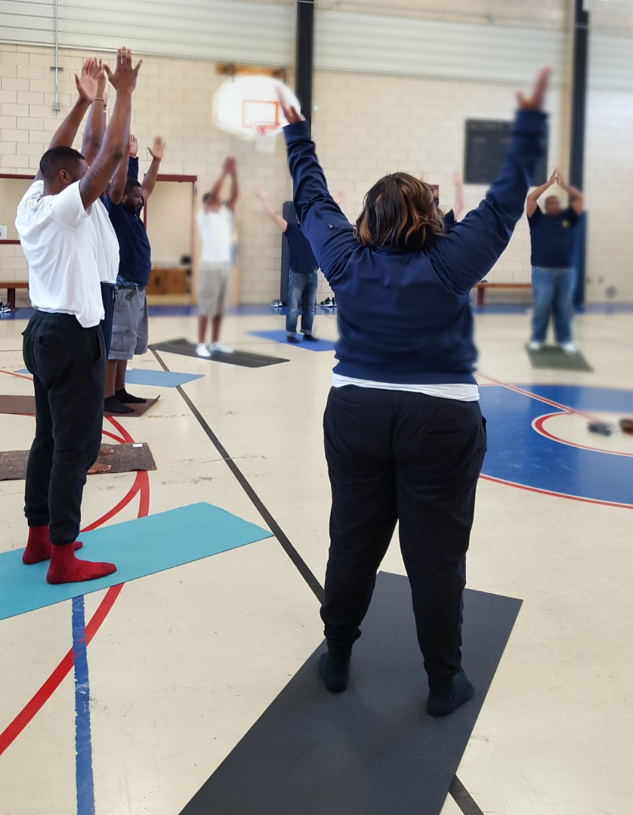
Reported benefits from students having taken classes are:
Reduction of stress
“More able to focus on the positive rather than the negative”
Support in addiction recovery
Greater mental clarity
Pain relief
Improved sleep
“Better able to deal with the mental and emotional strain of prison”
Greater access to inner peace

Slide 15
Positive Effects of Yoga
Yoga & Mindfulness have been shown to improve:
Stress (lowers cortisol)
Depression
Anxiety
Anger
Trauma (PTSD)
Eating Disorders
AD/HD (due to increasing dopamine?)
Attention, Concentration, Memory
Insomnia
Immune system function
Cancer, Chemotherapy
Obesity, Blood pressure
Chronic pain, Injury

Slide 16
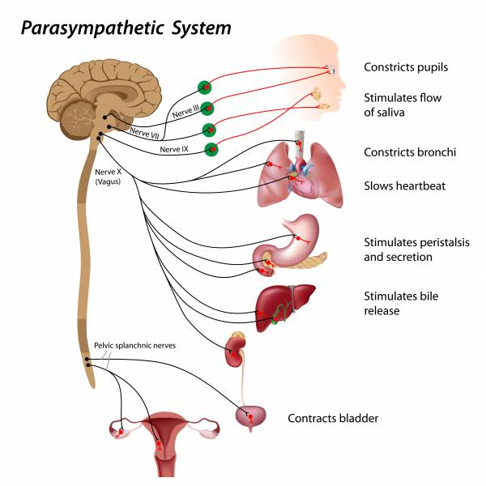
Vagus Nerve
Yoga (and deep breathing) mechanically stimulates the vagus nerve:
“Wanders” from brain, down either side of neck, connects at heart, and connects to ALL major organs
Largest nerve in the body
Controls motor and sensory functioning
brings info back to the brain
Regulates heart rhythms
Stimulates Parasympathetic NS, calms Sympathetic NS

Slide 17
Why Does Yoga Work?
Decreases Sympathetic Nervous System arousal
“Stress Response”
“Fight/Flight/Freeze”
Fight – Anger
Flight – Anxiety
Freeze – Depression
Most mental health problems relate to an over-stimulated SNS, which also affects physical health
Increases Parasympathetic Nervous System function
“Relaxation Response”
“Rest & Digest”

Slide 18
Sympathetic vs. Parasympathetic
Source: University of Washington

Slide 19
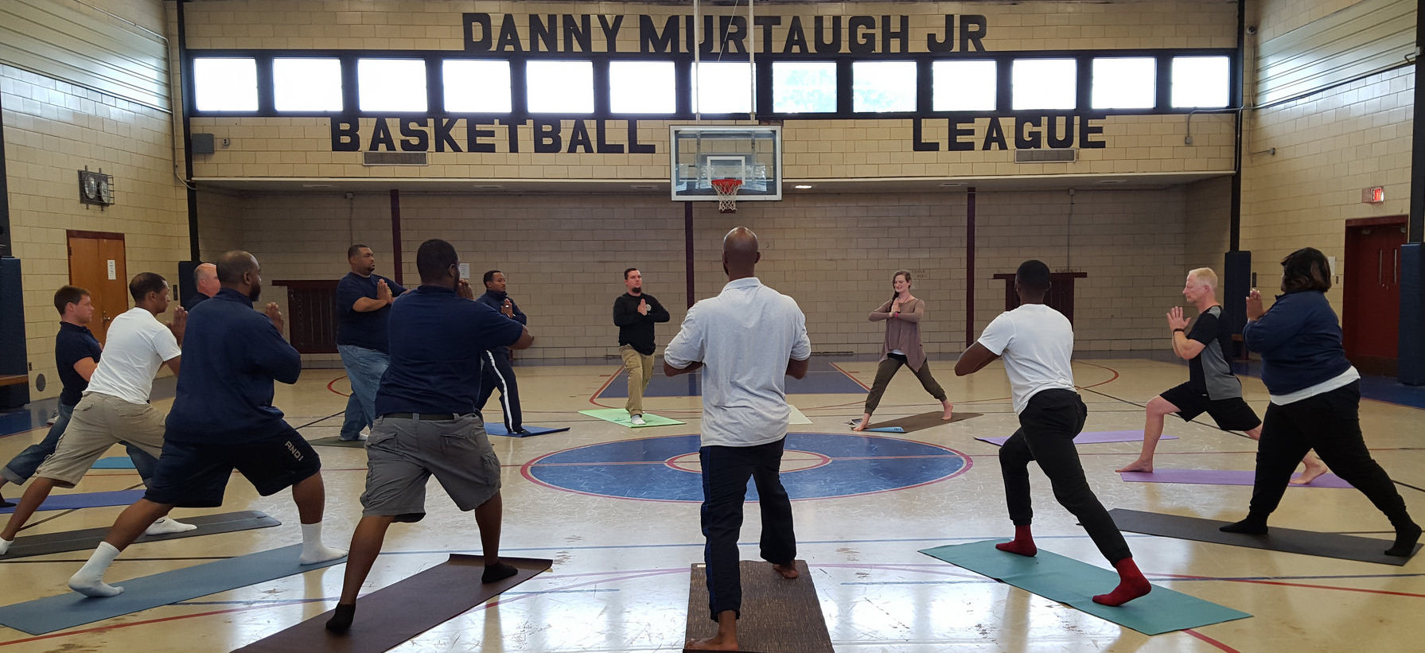
Why Yoga Helps
Teaches healthy life skills, including balanced exercise, and mindfulness
Provides an alternative stress relief that is healthy
Offers social interaction in a community focused on wellness
Regulates mood

Slide 20
Physical aspect
Helps reconnect with a body often neglected and abused by trauma.
For many there has been a disassociation from the body through trauma.
Teaches engagement of the relaxation response.
When the body is "stressed" (muscle engagement, back bends) and we consciously lengthen and deepen the breath we learn an appropriate way to live with stress off the mat.

Slide 21
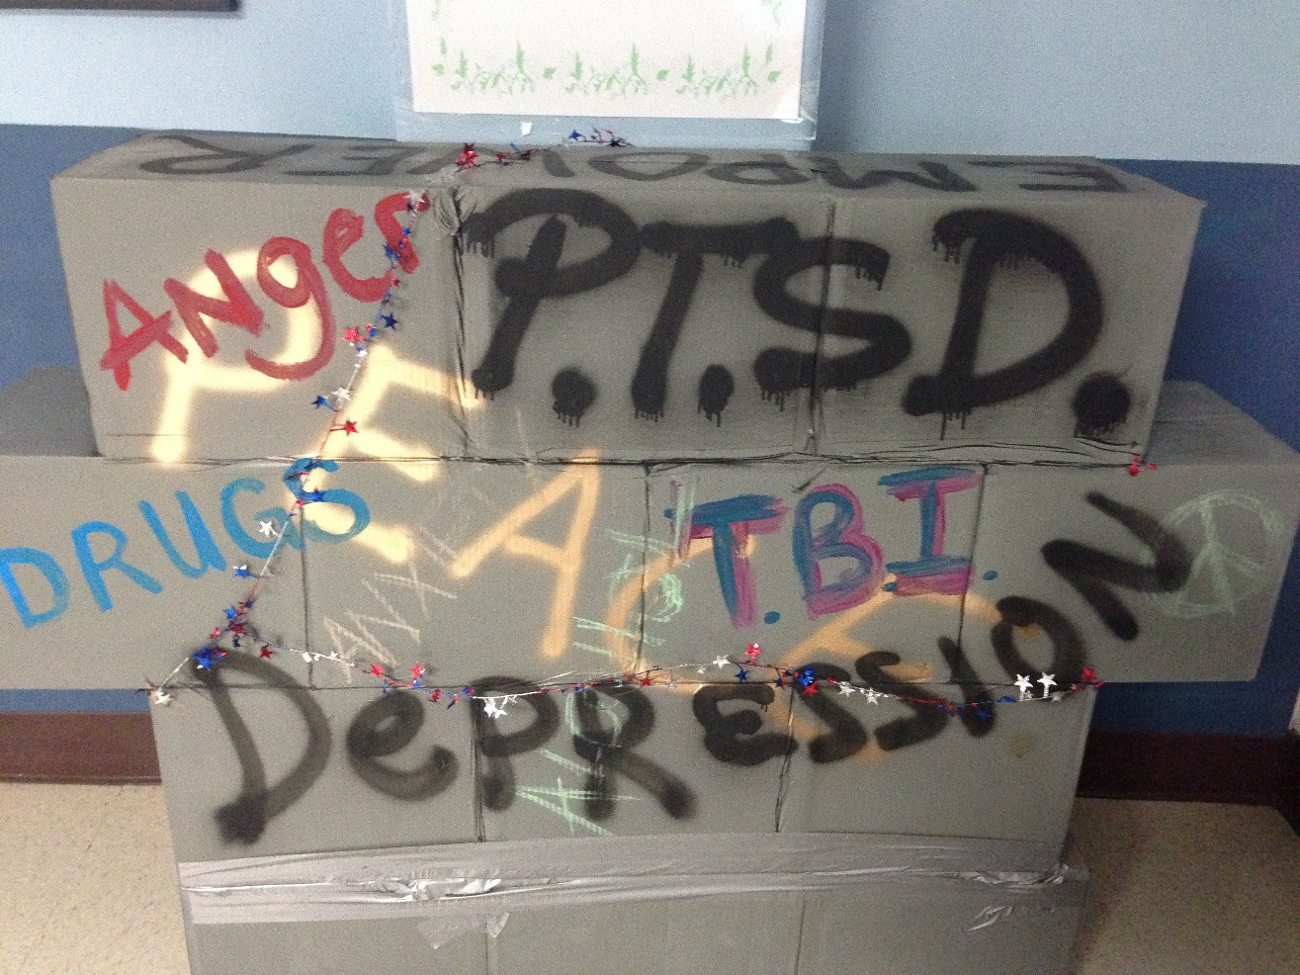
Breath work
Can be a key aspect of connecting the mind with the body.
The lungs are the link between the circulatory and nervous systems, and they provide detoxification, energy, and a built-in relaxation response.

Slide 22
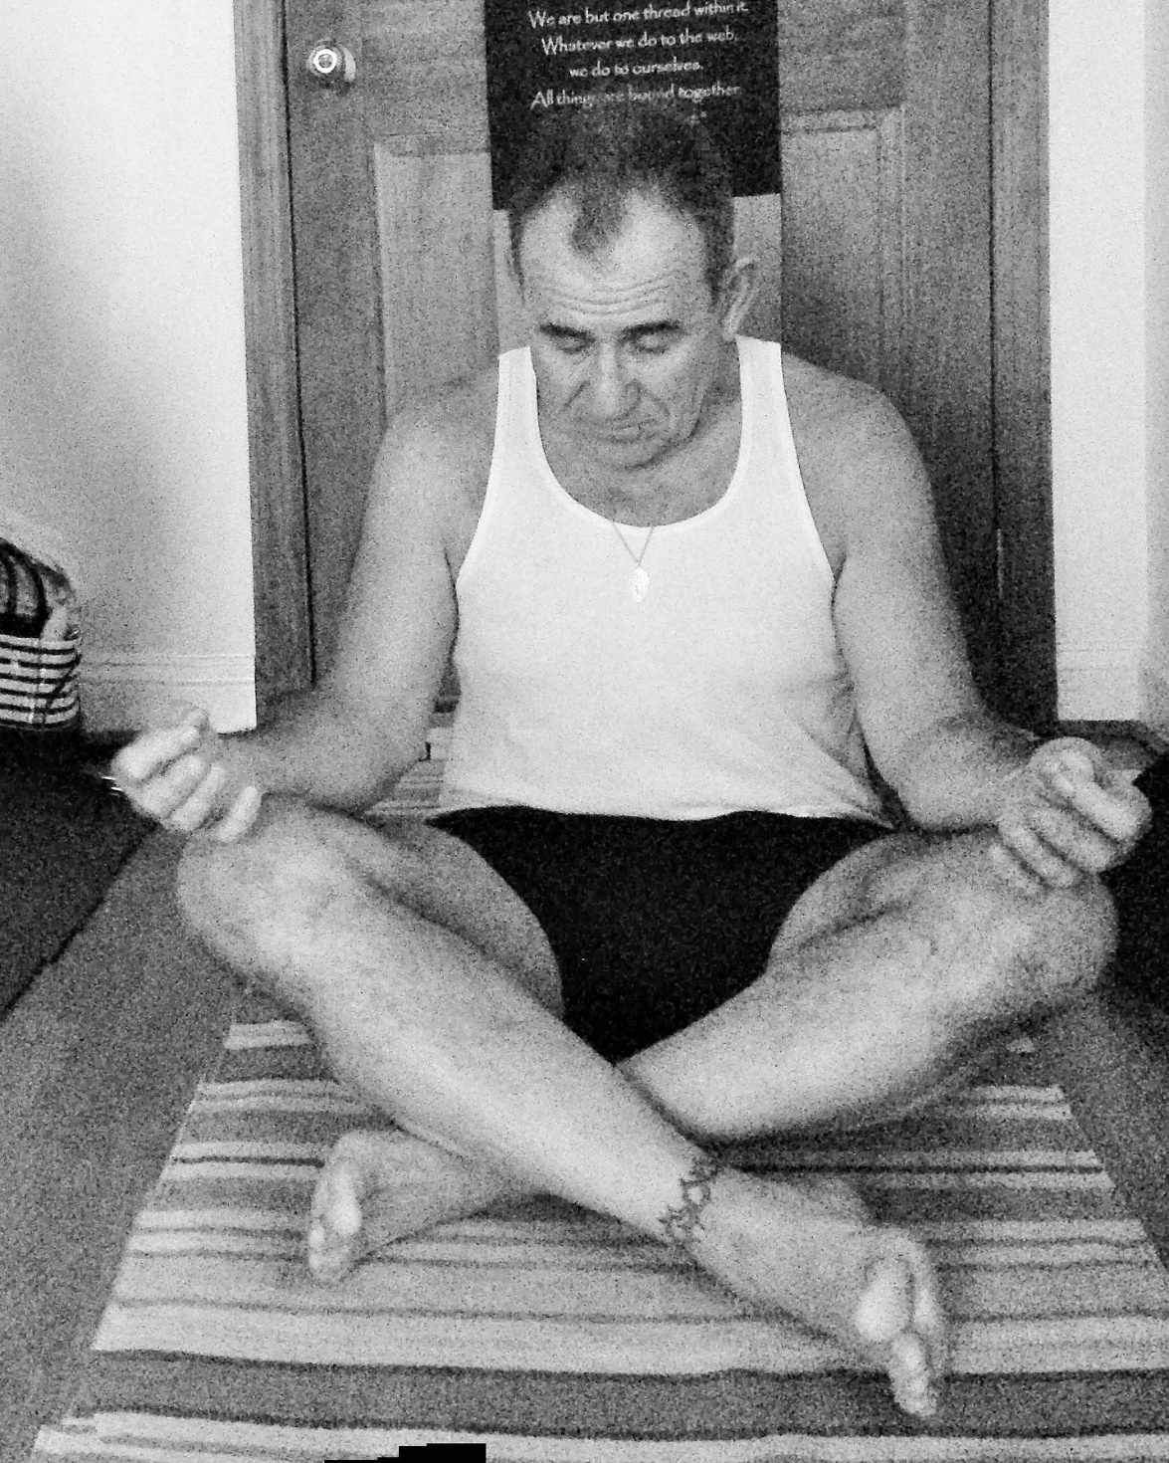
Meditation
Develops a process of letting go of thoughts.
Helps to discern the difference between thoughts and feelings allowing a deeper sense of self-awareness.
By becoming less influenced by the world around them, inmates can learn to release reactive behaviors.

Slide 23
Suggestions for Yoga Programs
Close collaboration between clinicians and yoga therapists
Trauma sensitive type of yoga
Strong screening/ intake process
Address potential triggers in:
Environment
Teacher attire & qualities
Language
Postures/ Exercises
Assists/ Adjustments
Gather student and clinician feedback, continue to refine the program

Slide 24
www.TransformationYogaProject.org
Facebook: Transformation Yoga Project
Michael Huggins: President & Founder
mike@transformationyogaproject.org

Slide 25
References
Emerson, D., Hopper, E. (2011). Overcoming Trauma Through Yoga: Reclaiming Your Body.
Khalsa SBS, Khalsa GS, Khalsa HK, Khalsa MK, Journal of Ethnicity in Substance Abuse
Rosen, T. (2014). Recovery 2.0
Simpkins, A. (2011). Meditation and Yoga in Psychotherapy: Techniques for Clinical Practice.
Van Der Kolk, B M.D. (2015). The Body Keeps the Score.
Weintraub, Amy (2012). Yoga Skills for Therapists: Effective Practices for Mood Management.
Weintraub, Amy (2004). Yoga for Depression: A Compassionate Guide to Relieve Suffering Through Yoga.

